Slide 1
PRESCRIPTION WRITING
BY
DR.SELVARAJU
ASSISTANT PROFESSOR
DEPARTMENT OF PHARMACOLOGY

Slide 2
PH 3.1 Write A Rational, Correct, and Legible Generic Prescription For A Given Condition & Communicate The Same To The Patient .

Slide 3
1. Prescribe for a 30 years old man suffering from Grand mal epilepsy

Slide 4
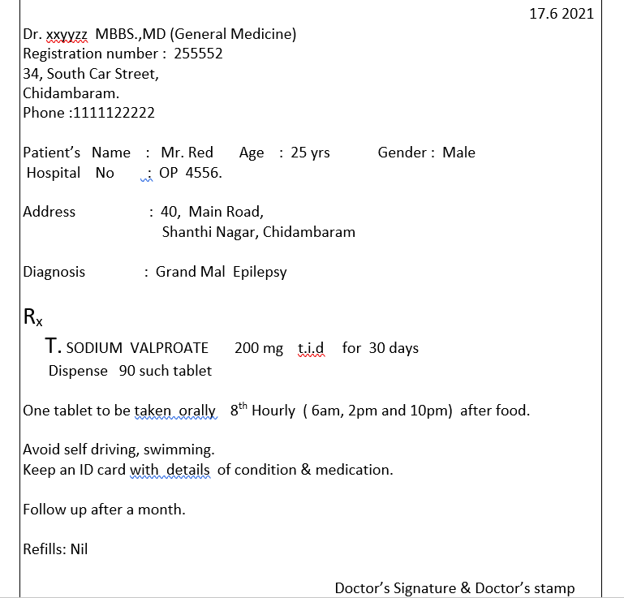

Slide 5
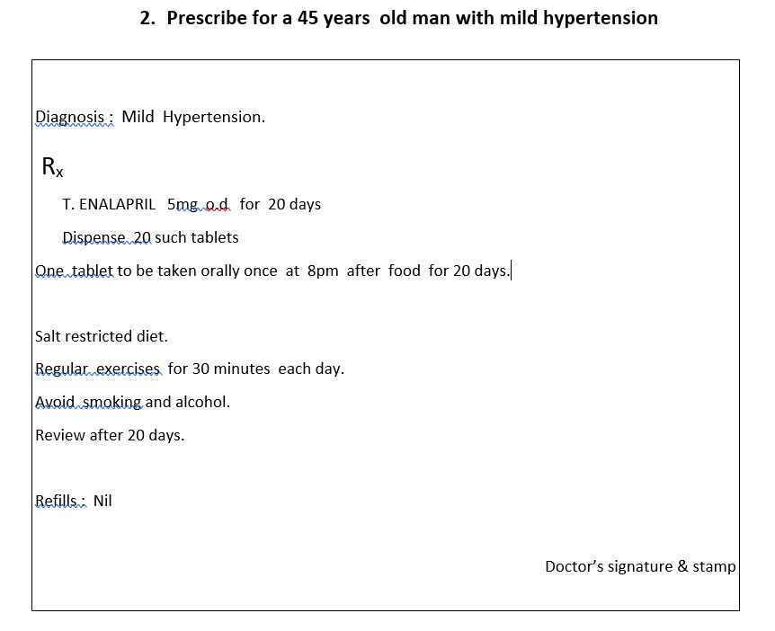

Slide 6
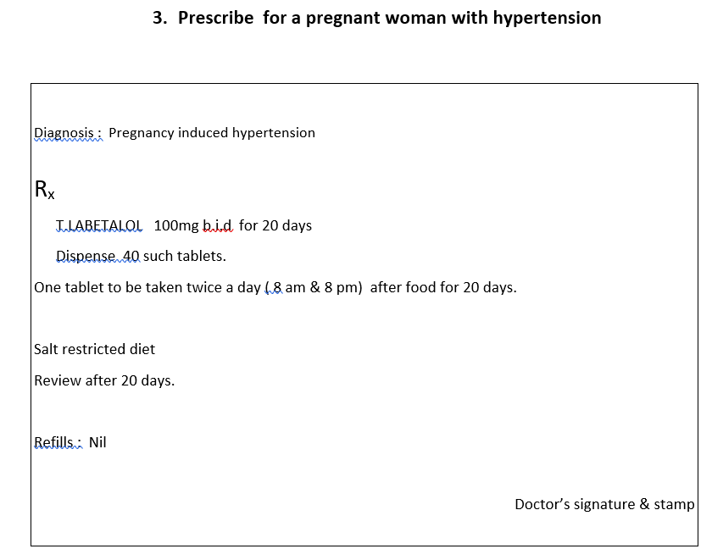

Slide 7
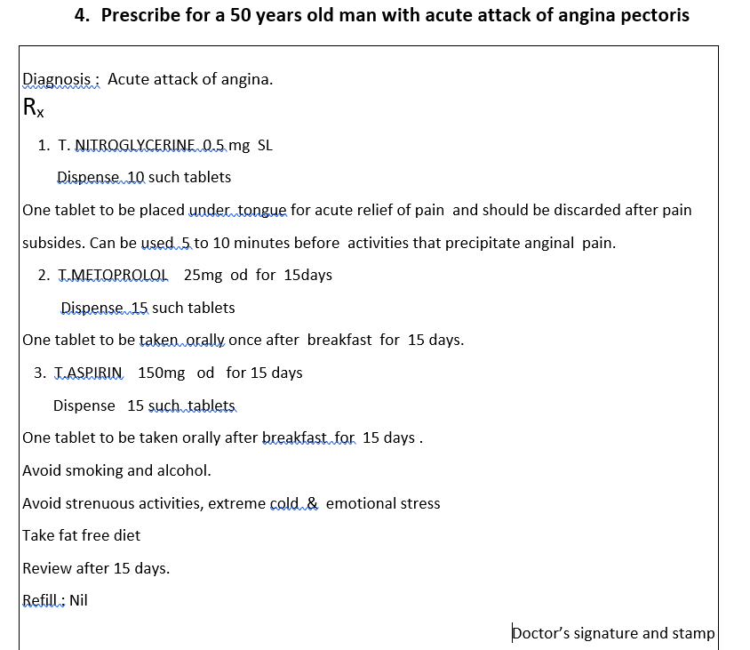

Slide 8
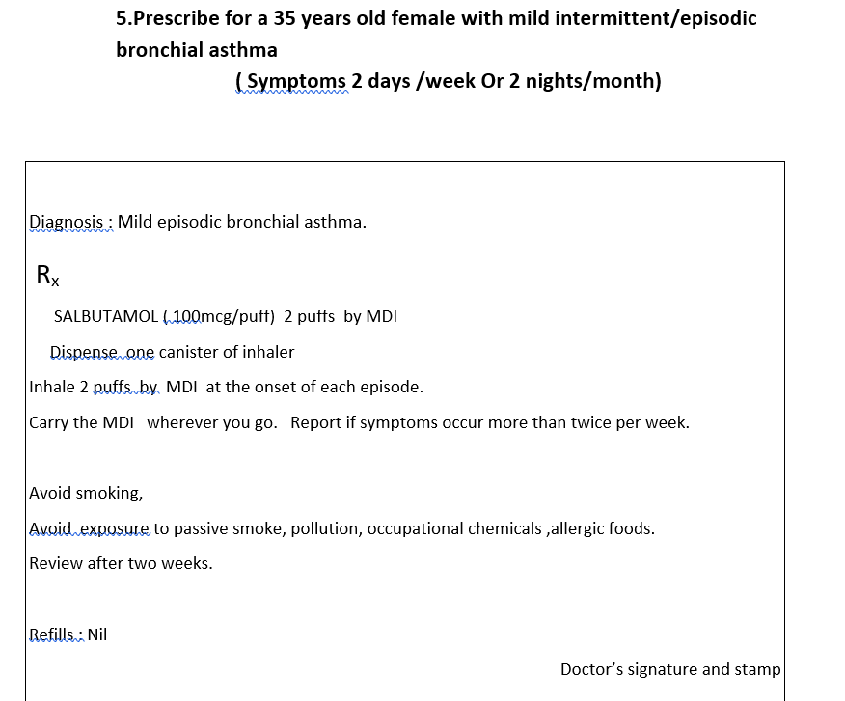

Slide 9
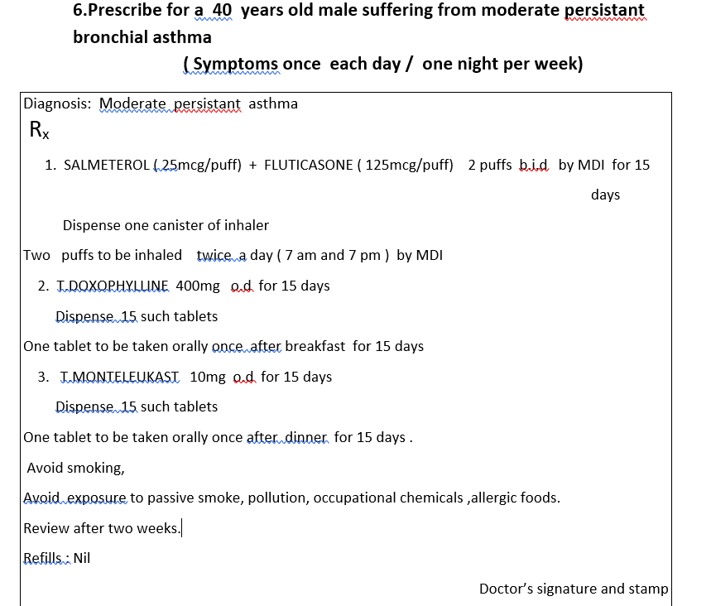

Slide 10
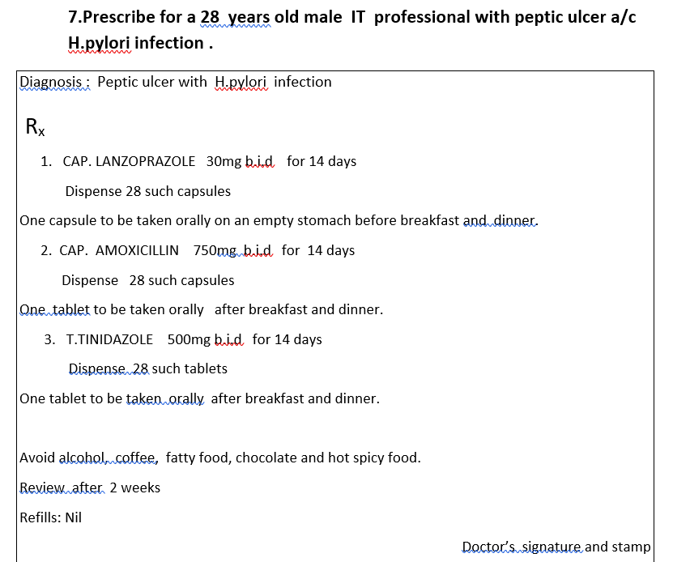

Slide 11
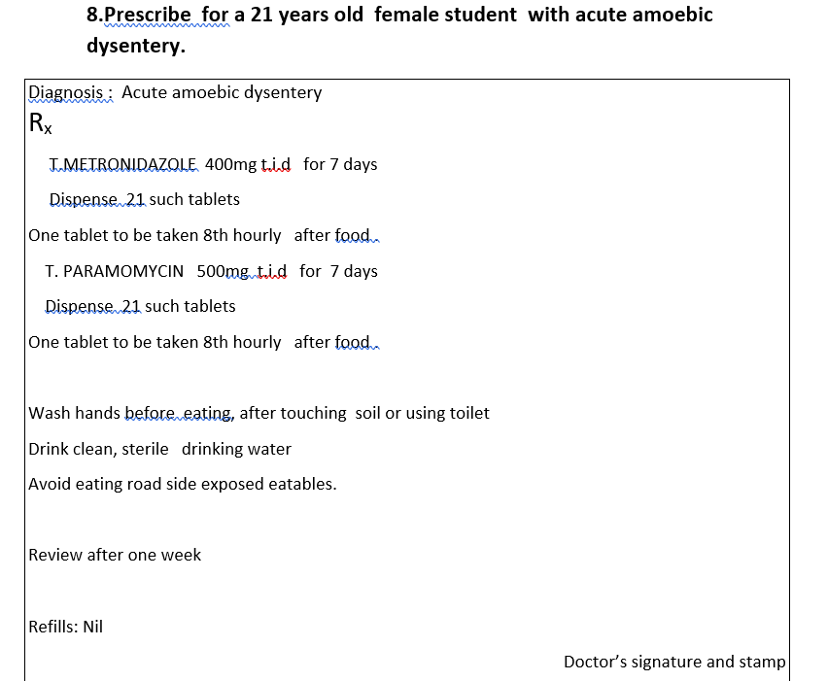

Slide 12
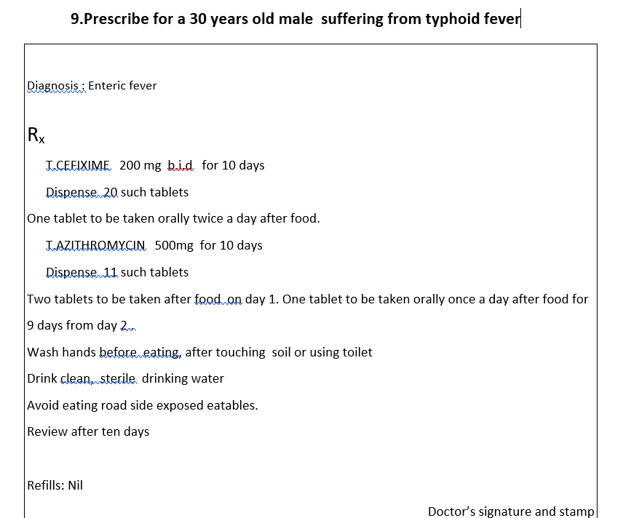

Slide 13
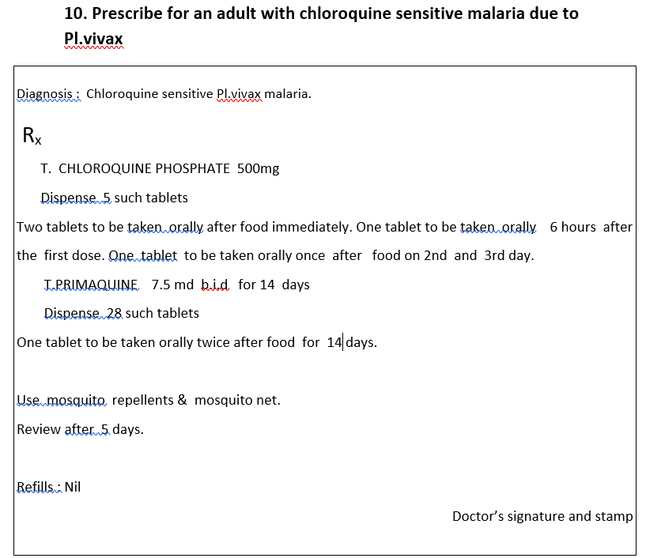

Slide 14
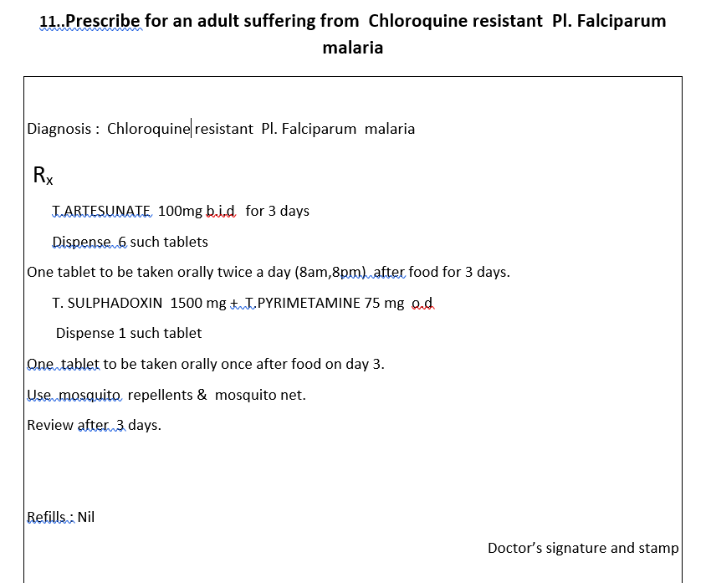

Slide 15
